Slide 1
EMPLOYEE DASHBOARD

Slide 2
INDEX
Abstract
Objective of project
Problem Statement
Scope & Motivation
Introduction
Literature survey
Existing Method
Disadvantages
Proposed method
Advantages
Project Flow
Hardware and Software Requirements
Architecture
Modules
UML Diagram
References

Slide 3
ABSTRACT
The employee dashboard is a comprehensive digital interface designed to enhance the efficiency, productivity, and engagement of a workforce within an organization. Serving as a centralized hub, the dashboard amalgamates critical information and tools relevant to employees, providing a real-time overview of key performance metrics, task assignments, upcoming events, and personalized updates. Through its user-friendly design and customizable features, the dashboard empowers employees to efficiently manage their tasks, track their progress, collaborate with colleagues, and access essential resources. Additionally, data visualization tools offer insights into individual and team performance trends, enabling informed decision-making at various organizational levels. By fostering transparency, communication, and data-driven insights, the employee dashboard optimizes workflow, bolsters employee satisfaction, and contributes to the overall success of the organization.

Slide 4
ABSTRACT
This abstract encapsulates the multifaceted benefits and functionalities of the employee dashboard, highlighting its pivotal role in modern workforce management and organizational dynamics. Online platform that facilitates the collection and analysis of feedback from students, faculty, and staff in a college or university setting
Keywords: Employee , Subject ,Student , Feedback , Hod , etc

Slide 5
OBJECTIVE OF PROJECT
“Employee dashboard” is software developed for maintaining the feedback information from students. The objective of employee dashboard is to provide a user-friendly and efficient platform that enables faculty to access relevant and up-to-date information about their feedback details, check the details by individually which subject getting good feedback.

Slide 6
PROBLEM STATEMENT
employee dashboard is software developed for getting feedbacks from students. It facilitates to access the feedback information of a particular faculty . By just a click on the mouse, the system will be able to produce the feedback report thus reducing the need for asking student manually in the class .

Slide 7
SCOPE AND MOTIVATION
Motivation:- Now a days faculty who are giving lecture in classes don’t know how student were feeling about hos class. If faculty want feedbacks, he can ask directly to the students but whenever directly asking feedbacks will come from students not properly. Here in this project student can give feedback in online directly particular faculty.
Scope:- the scope of a subject feedback management system may vary depending on the specific needs and requirements of educational institutions, but it should aim to provide an efficient and effective solution for collecting, analyzing, and managing feedback from students to improve the quality of education

Slide 8
INTRODUCTION
In today's fast-paced and dynamic work environment, organizations are continually seeking innovative ways to streamline operations, enhance collaboration, and empower their workforce. One such solution that has gained significant traction is the implementation of an employee dashboard. The employee dashboard serves as a digital cockpit, providing employees with a consolidated and user-friendly platform to access crucial information, monitor performance metrics, manage tasks, and engage with their colleagues.
As businesses grow and adapt to changing market landscapes, the need for efficient communication, data-driven insights, and seamless task management becomes paramount. Traditional methods of disseminating information and managing tasks often lead to fragmentation and inefficiencies, hindering both individual productivity and overall team cohesion. The employee dashboard addresses these challenges by centralizing essential data, tools, and resources in a single, accessible location.

Slide 9
INTRODUCTION
This project aims to develop and implement an advanced employee dashboard tailored to the unique needs of our organization. By leveraging cutting-edge technologies and intuitive design principles, the dashboard will revolutionize how our employees interact with information, collaborate with team members, and track their progress. This project holds the potential to not only boost operational efficiency and employee satisfaction but also contribute to informed decision-making by providing real-time insights into performance trends and key metrics.

Slide 10
LITERATURE SURVEY
S.NO | YEAR | AUTHORS | TITLE | OUT COMES
1 | 2003 | C. Emery, Tracy R. Kramer and Robert G. | critique of student evaluations of teaching effectiveness, Quality Assurance in Education | This paper performs a qualitative (e.g. case studies) and quantitative (e.g. empirical research) literature review of student evaluations as a measure of teaching effectiveness
2 | 2005 | J. T. E. Richardson | a review of the literature", Assessment & Evaluation in Higher Education | The paper concludes by discussing several issues affecting the practical utility of the instruments that can be used to obtain student feedback

Slide 11
LITERATURE SURVEY
S.NO | YEAR | AUTHORS | TITLE | OUT COMES
3 | 2004 | A. M. Zapalska, M. N. Bugaj, F. Flanegin and D. Rudd | Student feedback on distance learning with the use of WebCT | In this paper, This paper shows that using WebCT strongly contributed to the effectiveness of distance learning by improving the quality of students' comprehension in areas of critical thinking, problem solving.
4 | 2019 | T. Zarraonandia, P. Díaz, Á. Montero, I. Aedo and T. Onorati | Using a Google Glass-based Classroom Feedback System to-improve students-to-teacher communication | we present a communication system that makes use of a pair of Google Glass to provide the teacher with a constant and private flow of information on the students

Slide 12
LITERATURE SURVEY
S.NO | YEAR | AUTHORS | TITLE | OUT COMES
5 | 2014 | Indu Sharma, Anjali Singhal | Research on Online Examination System, , International Journal of Engineering Technology, | This application allows audience members to easily provide and quantify their feedback through a simple meter
6 | 2003 | R. Anderson, T. VanDeGrift, S. A. Wolfman, K. Yasuhara | Interaction patterns with a classroom feedback system: making time for feedback | In this paper, students gave feedback through the system that they would not have given aloud for lack of an appropriate moment— either because the feedback would be premature or tardy

Slide 13
EXISTING SYSTEM
Previously the employee dashboard used to take feedback on paper. The process is as follows o Approaching students of each section. o Distributing feedback forms of every faculty to each student. o Collecting the forms after students fill them. o Sorting of the forms according to Subject. o Accessing each faculty.

Slide 14
DISADVANTAGES
o It is time consuming.
o It needs lot of human effort.
o More time for accessing.
o Possibility of proxies.
o Possibility for human errors.

Slide 15
PROPOSED METHOD
In this new system we have provided a website where each student can give there feedback about their faculty and still their names kept unrevealed. This is done in this manner.

Slide 16
ADVANTAGES
o Easy interface for the administrator to work on.
o Easy access to students.
o Generating reports instantly.
o Less time consuming process.
o Less human errors and proxies.

Slide 17
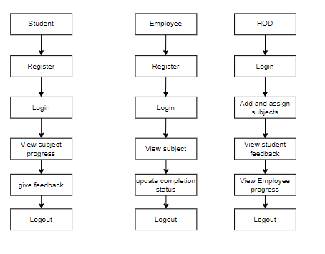
PROJECT FLLOW
Figure: work Flow of Proposed system

Slide 18
HARDWARE & SOFTWARE REQUIREMENTS
SOFTWARE REQUIREMENS
Operating System : Windows 7/8/10
Server side Script : HTML, CSS, & JS
Programming Language : JAVA
IDE/Workbench : Intellij IDEA

Slide 19
HARDWARE & SOFTWARE REQUIREMENTS
SOFTWARE REQUIREMENS
Technology : Java 1.7
Server Deployment : Tomcat Server
Database : MySQL

Slide 20
HARDWARE & SOFTWARE REQUIREMENTS
HARDWARE REQUIREMENTS
Processor - I3/Intel Processor
RAM - 4GB (min)
Hard Disk - 128 GB
Key Board - Standard Windows Keyboard
Mouse - Two or Three Button Mouse
Monitor - Any

Slide 21
FUNCTIONAL AND NON-FUNCTIONAL REQUIREMENTS
Requirement’s analysis is very critical process that enables the success of a system or software project to be assessed. Requirements are generally split into two types: Functional and non-functional requirements.
Functional Requirements: These are the requirements that the end user specifically demands as basic facilities that the system should offer. All these functionalities need to be necessarily incorporated into the system as a part of the contract. These are represented or stated in the form of input to be given to the system, the operation performed and the output expected. They are basically the requirements stated by the user which one can see directly in the final product, unlike the non-functional requirements.

Slide 22
FUNCTIONAL AND NON-FUNCTIONAL REQUIREMENTS
Examples of functional requirements:
Authentication of user whenever he/she logs into the system
System shutdown in case of a cyber-attack
A verification email is sent to user whenever he/she register for the first time on some software system.
Non-functional requirements: These are basically the quality constraints that the system must satisfy according to the project contract. The priority or extent to which these factors are implemented varies from one project to other. They are also called non-behavioral requirements.

Slide 23
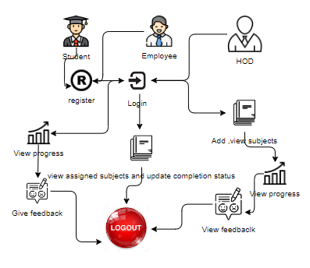
ARCHITECTURE

Slide 24
UML DIAGRAMS
Use Case Diagram:
A use case diagram in the Unified Modeling Language (UML) is a type of behavioral diagram defined by and created from a Use-case analysis. Its purpose is to present a graphical overview of the functionality provided by a system in terms of actors, their goals (represented as use cases), and any dependencies between those use cases. The main purpose of a use case diagram is to show what system functions are performed for which actor. Roles of the actors in the system can be depicted.

Slide 25
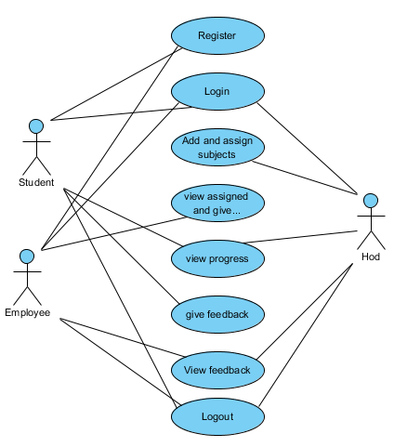
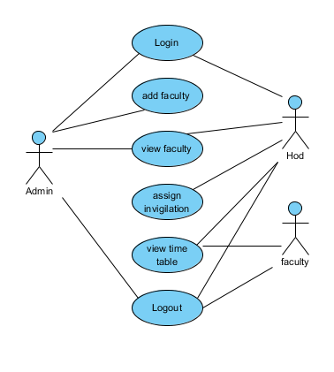
UML DIAGRAMS
Figure: Use Case Diagram

Slide 26
UML DIAGRAMS
Class Diagram:
In software engineering, a class diagram in the Unified Modelling Language (UML) is a type of static structure diagram that describes the structure of a system by showing the system's classes, their attributes, operations (or methods), and the relationships among the classes. It explains which class contains information.

Slide 27
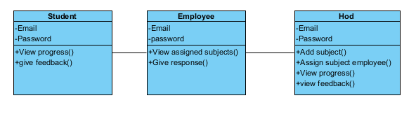
UML DIAGRAMS
Figure: Class diagram

Slide 28
UML DIAGRAMS
Sequence Diagram:
A sequence diagram in Unified Modelling Language (UML) is a kind of interaction diagram that shows how processes operate with one another and in what order. It is a construct of a Message Sequence Chart. Sequence diagrams are sometimes called event diagrams, event scenarios, and timing diagrams.

Slide 29
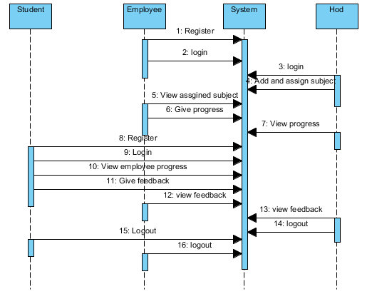
UML DIAGRAMS
Figure: Sequence diagram

Slide 30
UML DIAGRAMS
Collaboration Diagram:
In collaboration diagram the method call sequence is indicated by some numbering technique as shown below. The number indicates how the methods are called one after another. We have taken the same order management system to describe the collaboration diagram. The method calls are similar to that of a sequence diagram. But the difference is that the sequence diagram does not describe the object organization whereas the collaboration diagram shows the object organization.

Slide 31
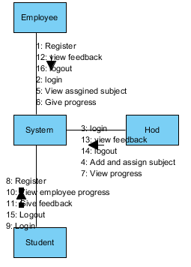
UML DIAGRAMS
Figure: Collaboration diagram

Slide 32
UML DIAGRAMS
Deployment Diagram
Deployment diagram represents the deployment view of a system. It is related to the component diagram. Because the components are deployed using the deployment diagrams. A deployment diagram consists of nodes. Nodes are nothing but physical hardware’s used to deploy the application.

Slide 33
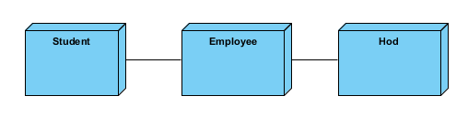
UML DIAGRAMS
Figure: Deployment diagram

Slide 34
UML DIAGRAMS
Activity Diagram:
Activity diagrams are graphical representations of workflows of stepwise activities and actions with support for choice, iteration and concurrency. In the Unified Modelling Language, activity diagrams can be used to describe the business and operational step-by-step workflows of components in a system. An activity diagram shows the overall flow of control.

Slide 35
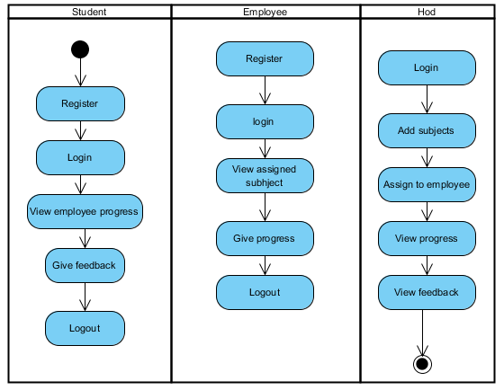
UML DIAGRAMS
Figure: Activity diagram

Slide 36
UML DIAGRAMS
Component Diagram:
A component diagram, also known as a UML component diagram, describes the organization and wiring of the physical components in a system. Component diagrams are often drawn to help model implementation details and double-check that every aspect of the system's required functions is covered by planned development.

Slide 37
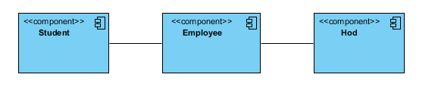
UML DIAGRAMS
Figure: Component diagram

Slide 38
UML DIAGRAMS
ER Diagram:
An Entity–relationship model (ER model) describes the structure of a database with the help of a diagram, which is known as Entity Relationship Diagram (ER Diagram). An ER model is a design or blueprint of a database that can later be implemented as a database. The main components of E-R model are: entity set and relationship set.
An ER diagram shows the relationship among entity sets. An entity set is a group of similar entities and these entities can have attributes. In terms of DBMS, an entity is a table or attribute of a table in database, so by showing relationship among tables and their attributes, ER diagram shows the complete logical structure of a database. Let’s have a look at a simple ER diagram to understand this concept.

Slide 39
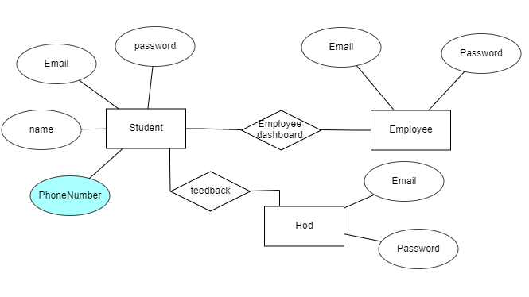
UML DIAGRAMS
Figure: ER diagram

Slide 40
UML DIAGRAMS
DFD Diagram:
A Data Flow Diagram (DFD) is a traditional way to visualize the information flows within a system. A neat and clear DFD can depict a good amount of the system requirements graphically. It can be manual, automated, or a combination of both. It shows how information enters and leaves the system, what changes the information and where information is stored. The purpose of a DFD is to show the scope and boundaries of a system as a whole. It may be used as a communications tool between a systems analyst and any person who plays a part in the system that acts as the starting point for redesigning a system.

Slide 41
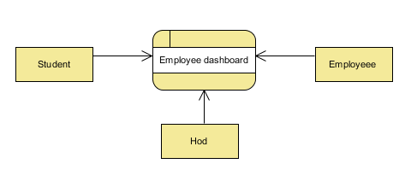
UML DIAGRAMS
Figure: Context Level diagram

Slide 42
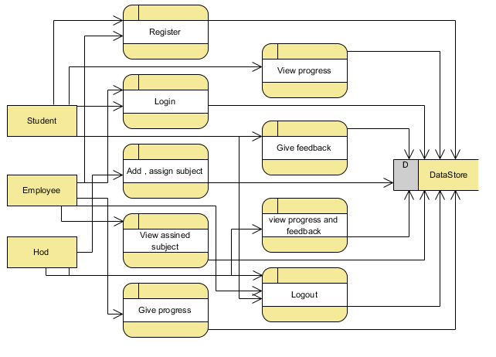
UML DIAGRAMS
FigureLevel-1 diagram

Slide 43
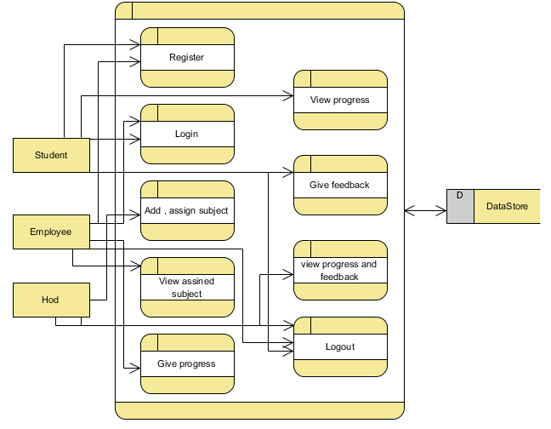
UML DIAGRAMS
Figure:Level-2 diagram

Slide 44
REFERENCES
[1] C. Emery, Tracy R. Kramer and Robert G. Tian, Return to academics standards: a critique of student evaluations of teaching effectiveness, Quality Assurance in Education, vol. II, no. 1, pp. 37-46, 2003.
[2] J. T. E. Richardson, "Instruments for obtaining student feedback: a review of the literature", Assessment & Evaluation in Higher Education, vol. 30, no. 4, pp. 387-415, 2005.
[3] A. M. Zapalska, M. N. Bugaj, F. Flanegin and D. Rudd, "Student feedback on distance learning with the use of WebCT", Computers in Higher Education Economics Review, vol. 16, no. 1, pp. 10-14, 2004.

Slide 45
REFERENCES
[4] T. Zarraonandia, P. Díaz, Á. Montero, I. Aedo and T. Onorati, "Using a Google Glass-based Classroom Feedback System to improve students to teacher communication", IEEE Access, vol. 7, pp. 16837-16846, 2019.
[5] V. Rivera-Pelayo, J. Munk, V. Zacharias and S. Braun, "Live interest meter: learning from quantified feedback in mass lectures", Proceedings of the Third International Conference on Learning Analytics and Knowledge, pp. 23-27, 2013.
[6] R. Anderson, T. VanDeGrift, S. A. Wolfman, K. Yasuhara and R. Anderson, "Interaction patterns with a classroom feedback system: making time for feedback" in CHI’03 Extended Abstracts on Human Factors in Computing Systems, pp. 880-881, 2003.

